Slide 1
Coxing

Slide 2
Coxswain responsibilities (in order of precedence)
1.monitor the safety of athletes, including yourself for heat, river conditions, boat traffic, cold, exhaustion, etc.
2.make judgement calls that align with safety, when in doubt, come back to the dock
3.protect the equipment. If you damage equipment while you are coxing, you are financially liable to repair it, so don’t hit anything!!! This is on land as well as on the water
4.steering
5. Coordination of who is rowing when
6.coaching, or making small corrections,this is the last priority, but if you have mastered 1-5, go ahead and try it. You don’t have to be a super advanced rower to know when something is wrong. You may not know how to fix it, but you can point out, 3 seat, you are rushing.

Slide 3
Coxing standards
Always give advance notice (except for emergency weigh enough)
Be clear and concise
Use standard calls if you know them, if not, be very clear in your communication
Always use a term like and up, and down, or ready up, ready down, etc. It is a lot easier to match timing when there is a word before the action word
When counting in 2, do something, always count on the catch.
Never, ever ever say. “You’re almost there” I don’t care if you are 10 feet from the buoys, no rower ever wants to hear that, and all coxswains have said it at least once

Slide 4
Body mechanics of carrying boats
When carrying a boat, the strongest position is on the shoulders, keep athletes there as long as possible
Low heads should be a very brief experience to avoid a specific obstacle and should be resolved with full heads or shoulders as soon as possible to avoid injury and boat damage
When athletes are stationary waiting for a race or the boathouse to open, bring them to waists so they can rest the boat on their leg

Slide 5
Coxswain calls for moving boats on racks, in order
Make sure everyone is on the correct side of the boat
Hands on
Up an inch & out (if on rack)
Reach across
Crawl under one at a time
To shoulders, and up
Walk it forward
Weigh enough
Reach across
Up over heads, and up
To water, and down
Up over heads, and up
Show shoulders
Split to shoulders
Walk it forward
To waist, and down
Reach across
Crawl under one at a time
Onto racks slowly
And down
Up over heads, and up
Show shoulders
Split to shoulders
Walk it forward
To waist, and down
Reach across
Crawl under one at a time
Onto racks slowly
And down

Slide 6
Getting into and out of the boat
Ports get oars, starboards get oarlocks (standard for lanching)
Oars across
One foot in, and down
Countdown from bow
One foot up, and out
Starboards get oars, ports get oarlocks (standard for docking)

Slide 7
In the boat commands turning the boat to starboard (turn you rudder with right hand forward)
We’re going to turn
Starboards to back, ports to row,
Ready back
And row…
Weigh enough

Slide 8
In the boat commands Pick drill
We’ll be doing pick drill by pairs, stern pair, then bow pair.
Stearn pair ready at the finish
Arms only on the square, and row
Add the body in 2 , that’s 1,2
Go to half slide in 2, that’s 1,2
Full slide in 2, that’s 1,2
Add the feather in 2, that’s 1,2
In 2, bow pair in, stern pair out…

Slide 9
In the boat commands pause drill example
We are doing a pause drill rotating through the pairs
Stearn pair ready at the finish, pausing every stroke.
Ready, row
Row… (after waiting for the pause to be effective every stroke)
In 2, middle pair in, stroke seat out, that’s 1, 2
In 2, bow pair in, 3 seat out, that’s 1, 2
In 2, book ends in, 2 seat out, that’s 1,2
Weigh enough

Slide 10
River directions
River directions are always given relative to if you are facing downstream. This avoids confusion with coxswain and rower’s right and left.
Turns are always called to port or to starboard
River right
River left

Slide 11
Knowing our river
-S turn
-Island (river left)
-house(river left)
-rest eddy (river left, watch out for submerged posts)
-bridge (enter river left span)
-lagoon (river left)
-treadmill (river right)
-the launch eddy, (river left)
-the launch eddy, (river left)
-summer launch eddy (river left)
-downstream rest eddy (river left)
-dead tree(river right)
-beach (river right)
-dock (river left)
-irrigation pipe(river left)
-mint farm (river left)
-turn around

Slide 12
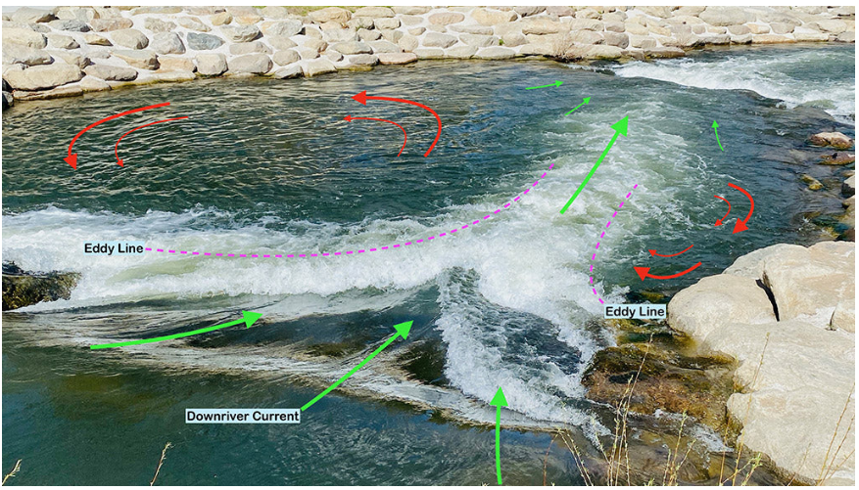
Understanding eddys
Eddys are along the banks of our rivers and have currents opposite to the flow of the river. They are useful and a pain in the butt.
They will turn the boat if you get on the eddy line, so knowing how to deal with them is key.
The picture shows a much more extreme eddy than our eddies, but it is very illustrative of what they look like.
We can use eddies for stopping and slowing down
Exit an eddy at the bottom for the least turning ability, or enter at the top at a 45 degree angle to the bank

Slide 13
Ferry angle
In high river currents, we almost always will go upstream, but sometimes you get stuck on the wrong side of the river. If you point your bow at 45 degrees upstream, it is much more efficient to cross than if you were to be perpendicular to the current, as the water actually pushes your boat across

Slide 14
Other river hazards
-logs
-gravel bars
-speed boats
-other manual boats
-fishing lines
-the bridge

Slide 15
On Regatta Day
"If all my coaches unexpectedly got called away to deal with something else, do I still know everything I need to know to get my boat launched?"
-bow number
-race number & event title example event 18, mixed novice 4+
-launch time
- -depends on race, when in doubt, go early
-1Ks. Launch about 30 minutes ahead, stretch 1 hour before, hands on 45 minutes before
-5Ks. Launch about 45 minutes ahead, stretch 1.25 hour before, hands on 1 hour before
-make sure boat doesn’t hit anything, when in doubt, weigh enough and go look to see if something will clear

Slide 16
Coxing a 1 k race
Know where the moves are, make a plan with the boat and coach ahead of time
Call out the start 5 by what they are, ¾, ½. ½, ¾, lengthen, full,
High ten (call the numbers and if you can add some flair)
Settle
Call 10 to breathe somewhere in the middle
Find out what motivates the athletes in your boat and say something for each of them at some point
Make sure to call power 10s, and the sprint
Periodically tell stroke seat (not the entire boat) if you are off stroke rate. Also tell them stroke rate right at the settle, and after the 500 and into the sprint at a minimum.
State position to other boats if it is possible to make a move to motivate crews, but if a move is impossible, don’t mention, “you’re 2 lengths behind another crew”
This is not a time to coach technique except boat set
Keep a straight course with the rudder, athlete power differentials should only be used in emergencies
Natalie Coxing, starts at 1:30 This is what realistically you will sound like if you aren’t a trained coxswain. I would probably be a little bit more excited if this had been recorded in a boat, but this was recorded in my office. The words are right, it just needs more enthusiasm.
https://www.youtube.com/watch?v=pOCWKG_8Eoc

Slide 17
Coxing a 5 k race
These are long, and you need a lot to talk about
Practice at home by trying to talk for 30 minutes straight
Motivational stories, jokes, 10s for everything under the sun, have them ready
Position in the race is important for athletes to know. Pay attention to buoys, and don’t be wrong when you state distances within the race
Reminders to sit up tall, or lengthen are good, but don’t get too into the details of technical coaching during a race
Don’t get hung up on stroke rate as long as the boat is moving efficiently, it will be slower than a sprint race
Know right of way rules, and follow them
Select a good line, the difference between a good line and a bad line in a head race can mean the world, especially when everyone else’s handicaps are so big.
Don’t hit anything!

Slide 18
Cox box-things to know
How to plug it in
What info it shows
How to reset it
How to wear it
Remember to take it out to the boat when you are done

Slide 19
steering
Push the hand forward the direction you want to go (opposite of driving a car or riding a bike)
Try to only steer when blades are in the water (it really affects the set when you do it on the recovery) go back to neutral in between
Most of our boats have something signifying the neutral position
Small movements are very important, don’t over correct
It usually takes about 3 strokes to see results of when you change direction, so if you only need a little change, you may stop steering before you see a change.
If you wait until you are pointed at the correct direction to stop steering, you will overcorrect
Some boats are more agile than others and turn faster. The 8+ for example, steers like a dream, some new coxswains hate it because it is so responsive, but small movements are key

Slide 20
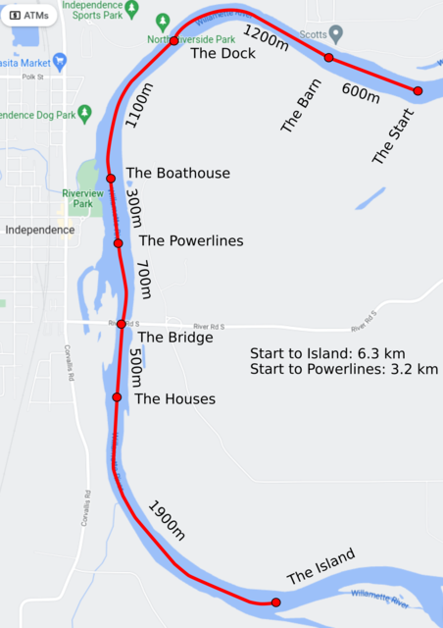

Slide 21
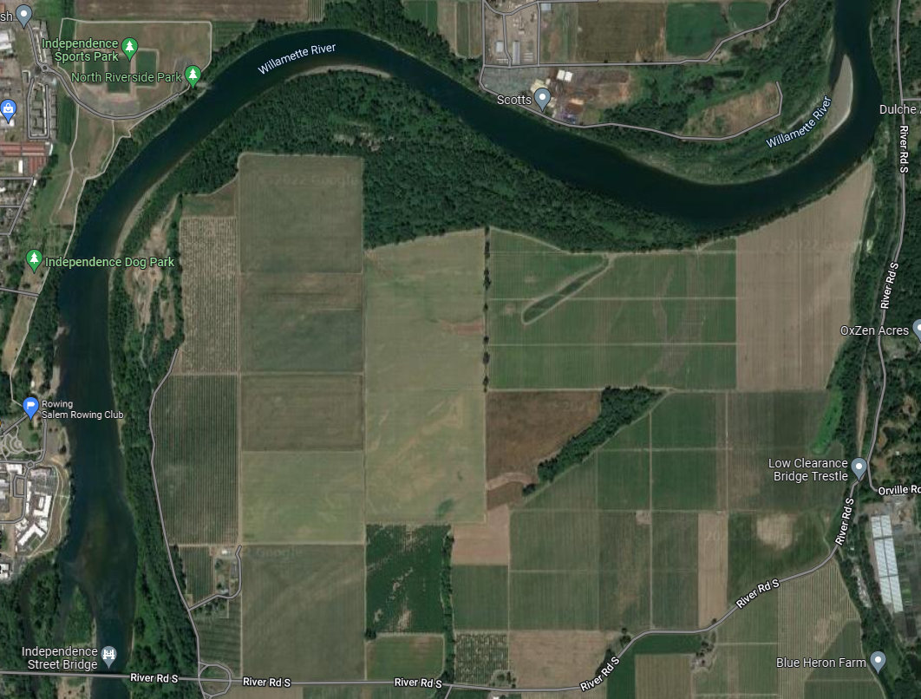
Irrigation Pipe
Dock
Mint Farm
Mint Farm
Beach
Turnaround
Dead Tree
Summer Eddy
Summer Launch
Normal Launch
Power Lines
Lagoon
Bridge

Slide 22
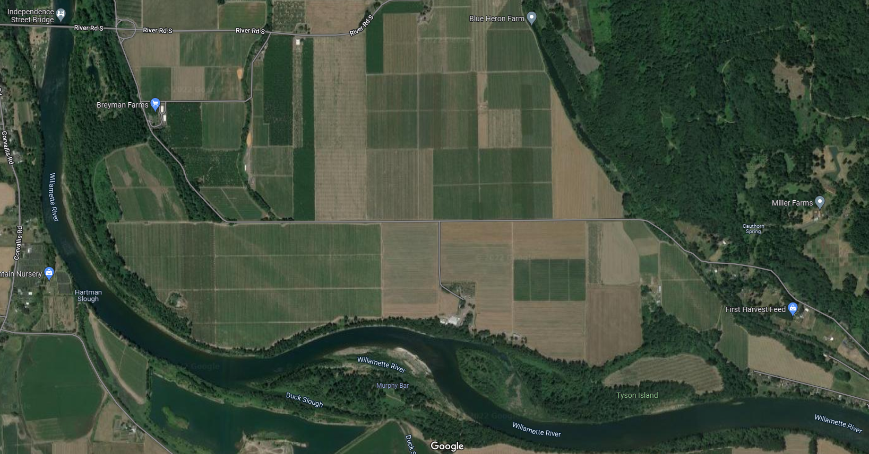
Bridge
Rest Eddy
Houses (approx.)
Pipe 1 (approx.)
Pipe 2 (approx.)
S-turn (adv. only)
Island
???
Upstream record!

Slide 23
Maneuvering basics
When rowing, bow pair has the most leverage
When backing, stern pair has the most leverage
If the boat is moving, holding water on one side is the fastest way to turn it safely
If the boat is not moving, rowing on one side and backing on the other is the fastest way to turn it
Try not to overshoot turns – stop before you get there
Experiment with different rowers and stroke intensities to turn
If you miss the dock/ramp, GET AWAY from the shore as quickly and safely as you can, get back out into the middle of the river and enter the traffic pattern again. It’s much better to accept defeat and try again than damage something.

Slide 24
Maneuvering calls
Tap it – row arms only, light strokes
Tap it up – used at start of pieces to get aligned with other boats
Back it – take a reverse stroke, pushing the handle away from you while the blade is in the water
Two scull bow: bow seat hands two seat their oar, and two seat takes light strokes to align the boat without pulling it away from a stakeboat
Three scull two: three seat takes light strokes with two seat’s oar to align the boat
Check it – drag blade through the water at 45 degrees
Hold water – drag blade through the water while square
Add in – instruct someone who wasn’t rowing to join
Drop out – instruct someone who was rowing to stop
Sit easy – no need to do anything anytime soon
You can instruct rowers to give different stroke strengths – normal, light, paddle, tapping, etc.

Slide 25
Running Drills
Drills are usually done at lighter-than-full pressure and require more coordination from coxswains. The goal is to work technical skills
Be very clear with the instructions for the drill and check to make sure everyone understands what to do. If needed, have experienced rowers demonstrate first
Try to stay consistent with your timing and counting strokes – it’s your job to coordinate the drill
It’s especially important to give advanced notice when things change – I like it when there’s advanced notice, the count off, and then a repeat of the command (e.g. In two, stern pair drop out, 3 and 4 add in. That’s 1, 2, stern pair out, 3 and 4 in)
Try to provide technical feedback where you can
Common calls for drills: pauses (and associated commands to row/go), add in, drop out, on the square/feather, rate changes, pressure changes, sequence changes (arms/body/legs only, etc).

Slide 26
Running Pieces
Pieces are usually done at full pressure, but not always. The goal is to achieve a workout.
Your rowers are going to be too focused on the workout to manage the piece, so it’s your job to manage it for them. You have the only clock in the boat.
Remember, safety is your first priority, followed by steering, followed by coordinating the piece
Build at the start: at rates higher than 24spm or so, you’ll need to take a few strokes to build into the piece. “Ready, go. Five to build, there’s 1, 2, 3, 4, 5”
Settle into the target rate. “Settle here, you’re at a ___”
Note progress throughout the piece. This includes time calls, distance calls, etc.
Monitor stroke rate and provide minor technical feedback
Coordinate rate changes, pressure changes, etc. Keep track of the clock!
Provide motivational calls and plan moves on other boats as needed
Finishing the piece
Let it run – rowers all pause at the finish and try to keep the boat’s balance as long as possible
And, down – rowers drop oars to the water and sit easy
Paddle / paddle it out – rowers drop pressure and rating and take 10-15 strokes to cool down and recover. This is especially important for very hard pieces

Slide 27
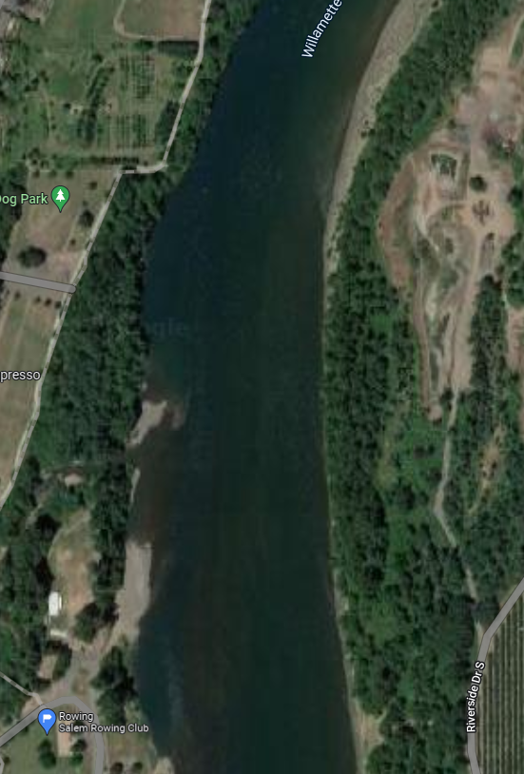
General river traffic pattern
These instructions are relative to the part of the river that is deep enough to be in (accessible channel), not the full river width. Everything is relative.
Please note that non-rowing boaters often don’t follow these rules even though they are supposed to, so be extra vigilant looking for motor boats and other non-motorized boats in wa
Stay to the port side of the accessible channel unless making special maneuvers (turns, docking, launching, shooting the bridge, etc.)
Before you stop or make a special maneuver, check around you to make sure you’re in a safe place to do it
Boats making special maneuvers have the right of way
Boats overtaking other boats have the right of way – move toward the outside of the turn if you’re getting passed to give the other boat the better line and reduce passing time.
If it is not safe to pass, don’t pass. This is especially true in low water.
Don’t be afraid to coordinate with other people on the water!

Slide 28
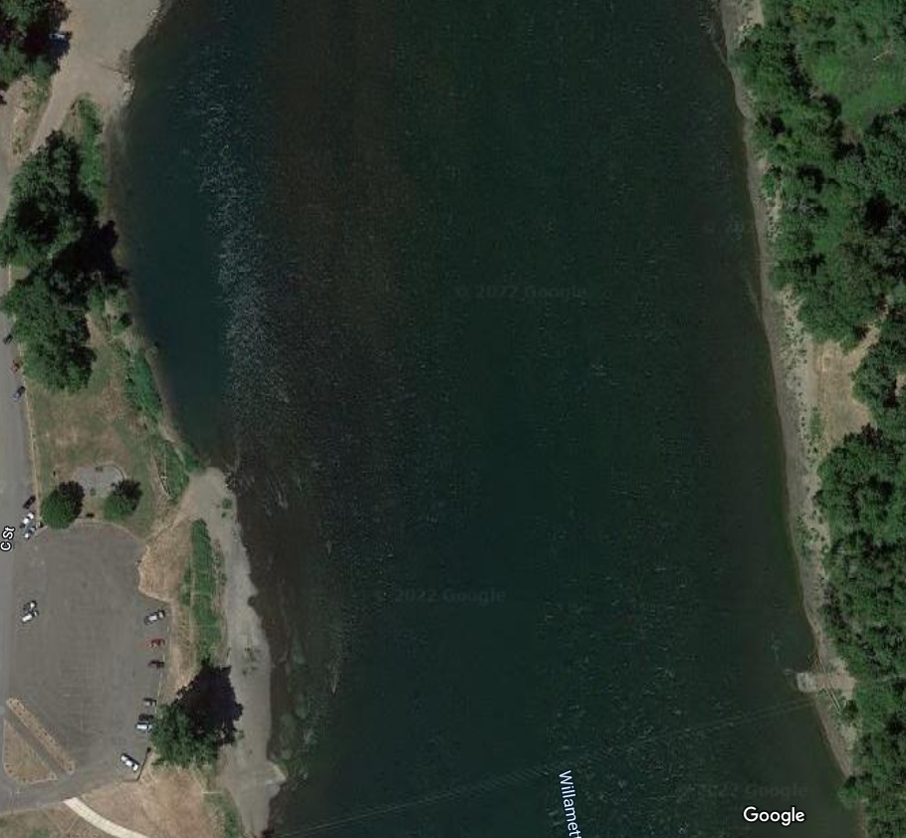
Docking in the normal launch area from upstream (high water only)
1
Enter the traffic pattern at the power lines facing down stream
Turn 45-60 degrees to port; take 5-10 strokes to cross the river, aiming at the upstream end of the eddy. Be careful not to go too fast; you can drop down to bow pair as you get close. Watch the sandbar!
As you cross the eddy line, have starboards hold and ports row to face downstream. You will have to fight the eddy on this. At times it will spin you, go with it, and be adaptive.
Have bow pair row slowly to the dock, gently modulating pressure. Drop down to arms and body as you get close, then to arms only. Have someone on starboard (3 or 7 seat) hold water to turn the boat parallel to the ramp
2
4
3
3
4
2
1

Slide 29
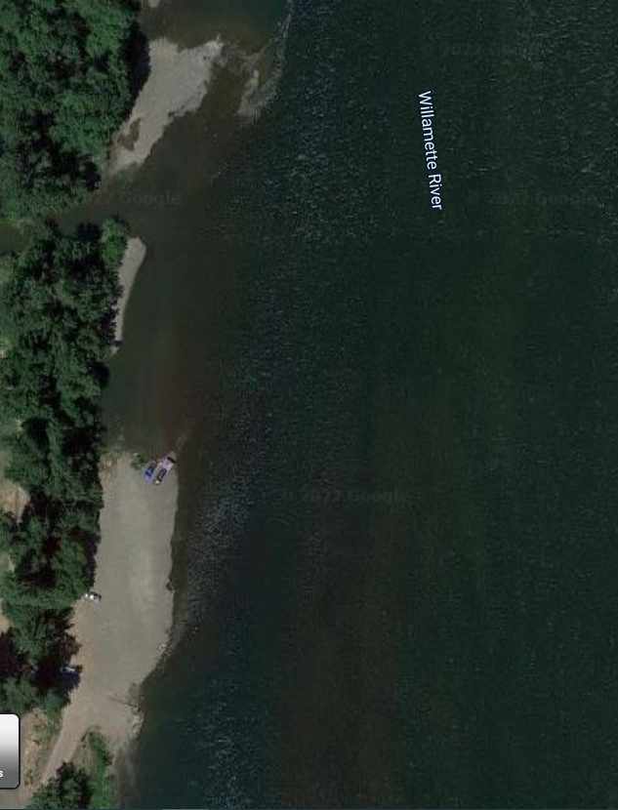
Docking in the normal launch area from downstream
1
Enter the traffic pattern near the summer launch area
Take 20-30 strokes to get close to the beach, but not too close; watch your skeg! There is a log, concrete chunk, rock and/or sign depending on water level. Know where they are.
Turn 20-30 degrees to starboard to cut in close to the ramp. Drop down to bow four/pair to slow down
As you get toward the dock, have someone on port hold water to spin the boat parallel to the dock, or you can row straight in
1
2
2
3
3
4
4

Slide 30
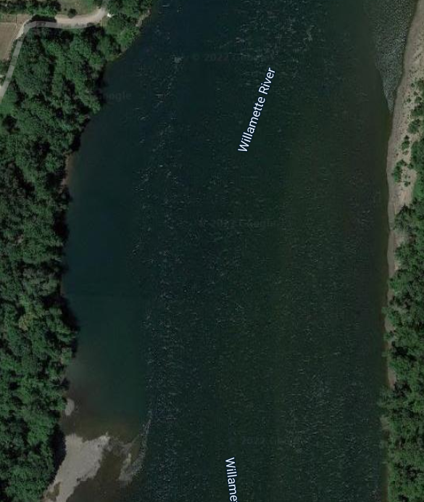
Docking in the summer launch area
Enter the traffic pattern in the downstream end of the eddy
Row slowly straight toward the beach along the shore, using only bow pair/four, dropping down to bow pair and arms and body only. Go slowly and check your depth.
As you get within about a boat length of the shore, have ports hold water HARD to turn the boat parallel to the shore. You may need to have a rower tap or back to get aligned
1
1
2
2
Note: do not attempt to dock at the summer launch area from upstream. You will hit the sandbar.
3
3

Slide 31
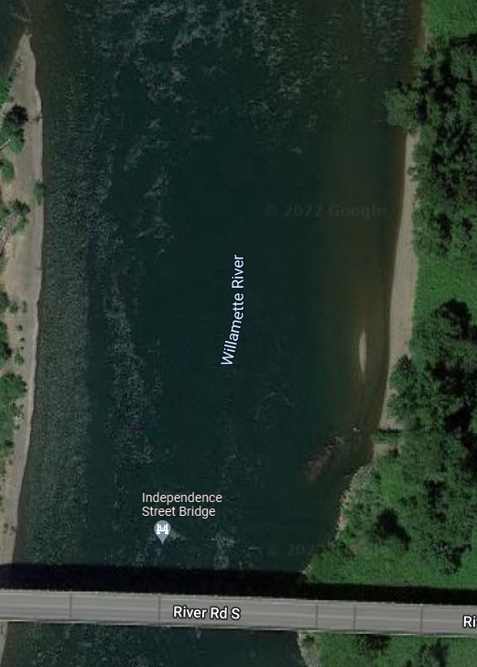
Shooting the bridge, going upstream
1
Start getting ready as you get to the lagoon. Cut across to river left (starboard)
Locate the two eddies from the pylons and shoot the gap between them. The pylon to river right (port) has a stronger eddy, so try to stay to starboard. The current will suck you to port though.
Once you’re through, you’ll need to commit to at least 100 more strokes to get to a safe place before stopping so you don’t float back into the bridge. Try to get even with the rest eddy upstream
If you mess up your line before the bridge, WEIGH ENOUGH and float back down. You can always try again before any part of the boat crosses into the bridge plane (but not when you’re coming back)
2
1a
1b
1b
3
2
4

Slide 32
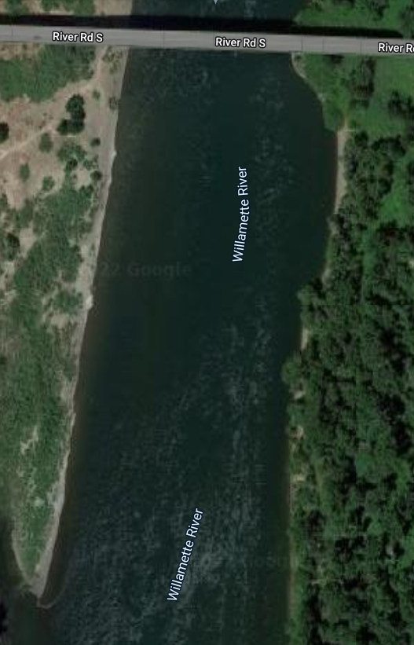
Shooting the bridge, going downstream
You get one shot! Start getting ready as you get to the rest eddy.
Try to stay at river left (port). When starting, take it slow with 2 or 4 rowers. Be sure you can do this confidently before going faster
If you mess up, there is not a lot you can do to fix it. Stay alert and be prepared to make emergency calls confidently. You may need an entire side to hold water or the whole boat to weigh enough
1
2
2
3
1

